Slide 1
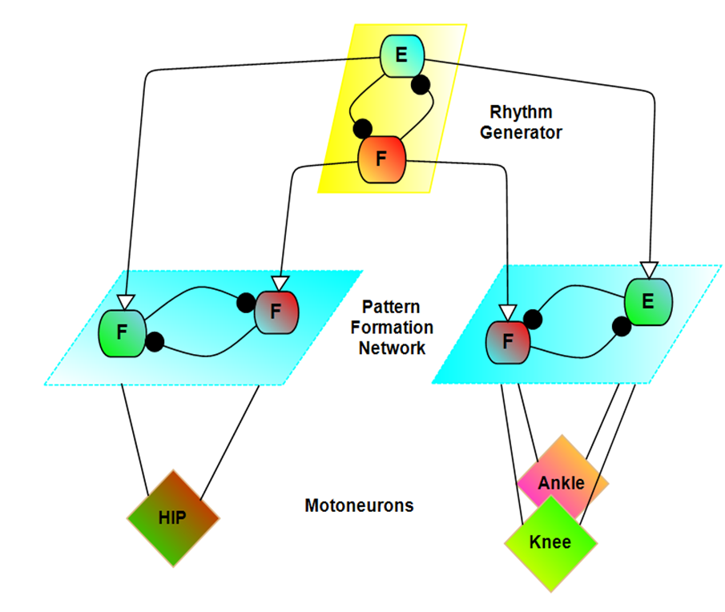
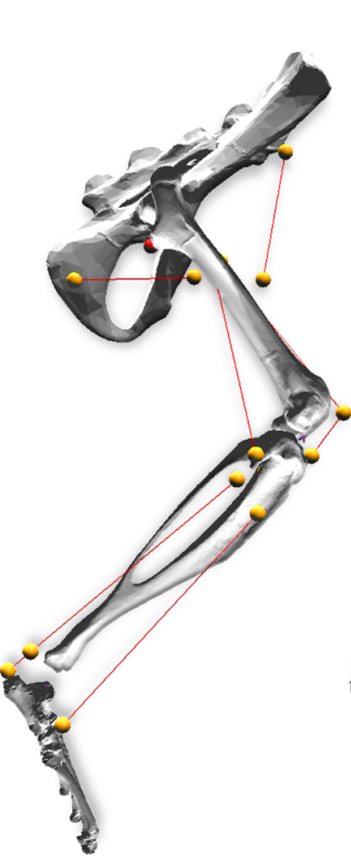
Overview of previous model
Monoarticular antagonist muscles
Individual joint control
Two-layer CPGs
Replicate Walking
Reproduced non-resetting deletions
Kinematics not match well,
especially on the ankle joint

Slide 2
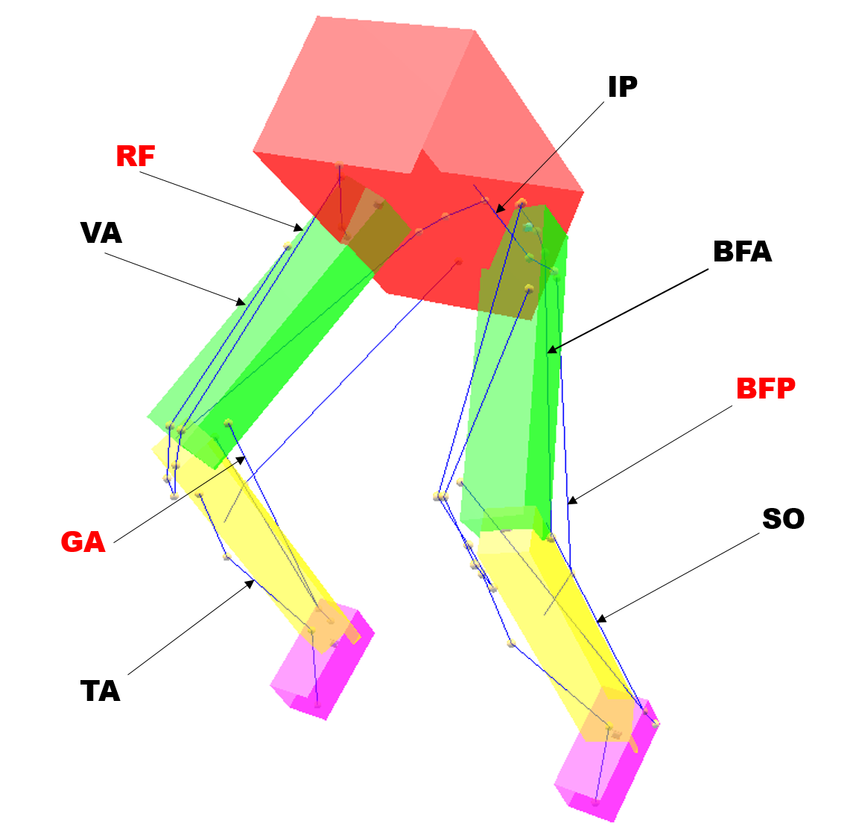
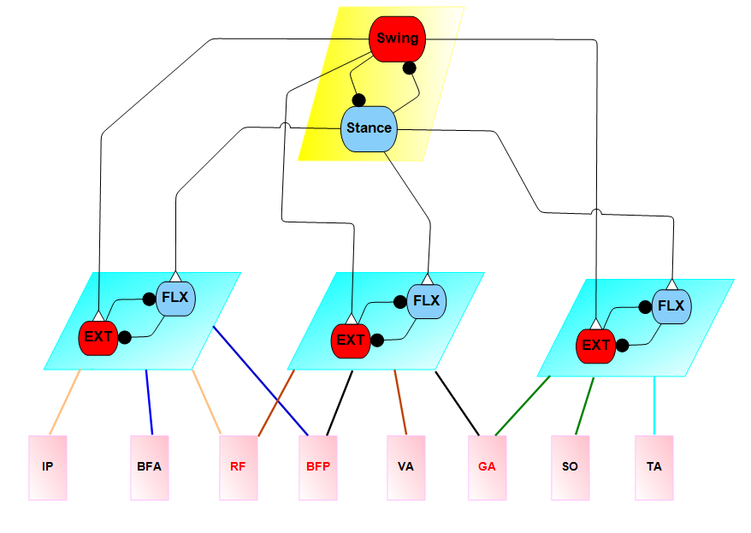
Biarticular muscle model
The biarticular muscle model include 8 muscles, 3 of them are biarticular muscle (red).
IP
BFA
BFP
RF
VA
TA
GA
SO
Iliopsoas
Anterior biceps
Posterior biceps
Rectus femoris
Vastii
Tibialis anterior
Gastrocnemii
Soleus
Hip Flexion
Hip Extension
Knee Flexion
Knee Extension
Ankle Flexion
Ankle Extension
Notes:
Orange connections represent hip flexion; blue connections represent hip extension; brown connections represent knee extension; black connections represent knee flexion; green connections represent ankle extension; and the cyan connection represents ankle flexion.

Slide 3
Inverse Kinematics of Biarticular muscle
We used joint motion data to simulate desired walking profile of rat. The muscle profile of leg during walking then could be used to calculate the desired MN activations for biarticular muscle model.

Slide 4
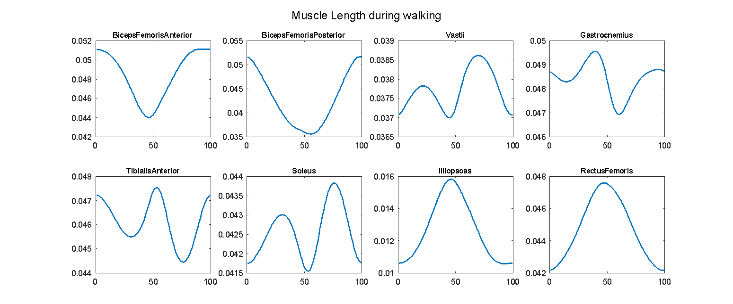
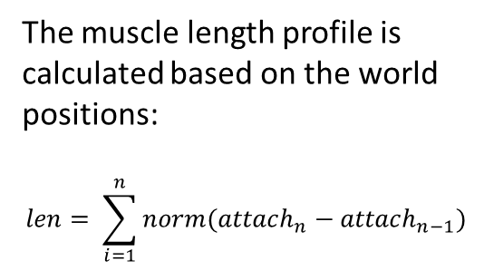
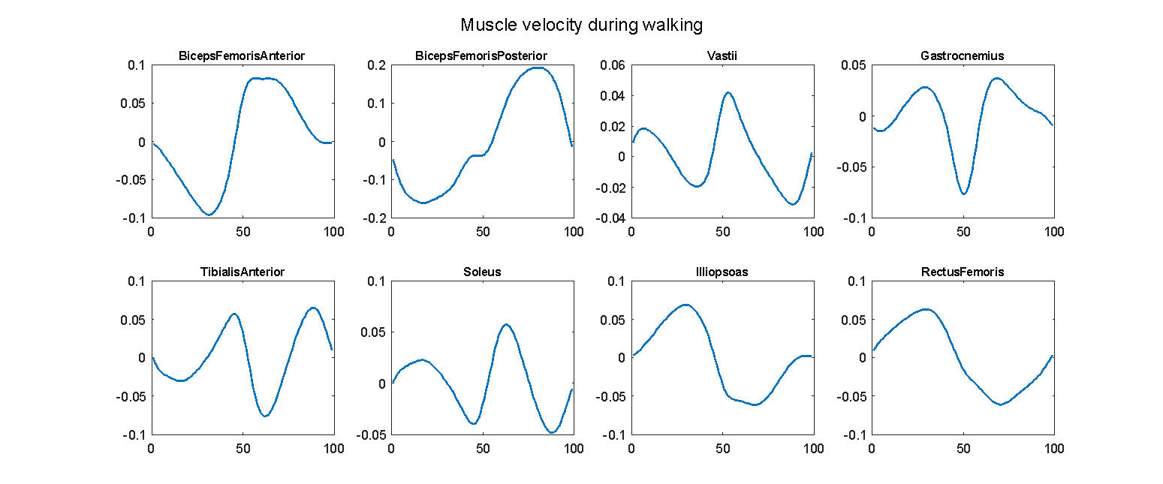
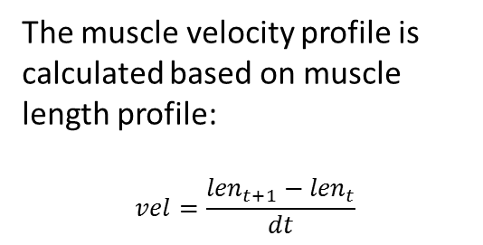
Muscle motion Profile

Slide 5
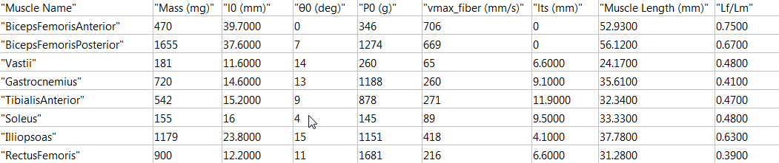
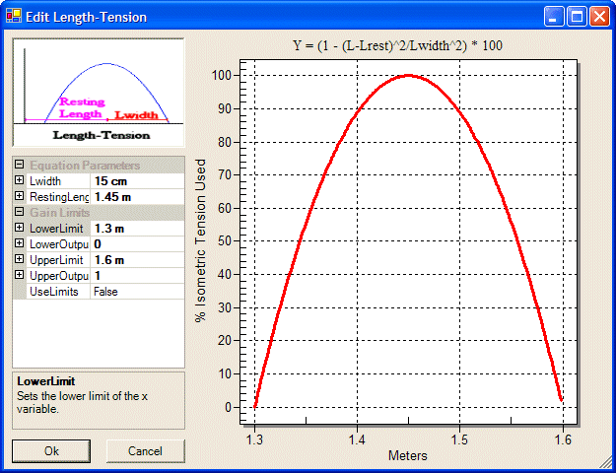
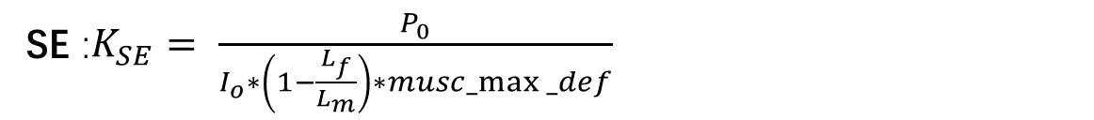

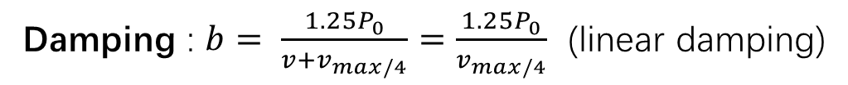
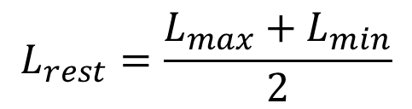

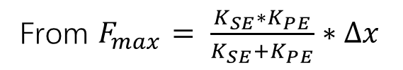
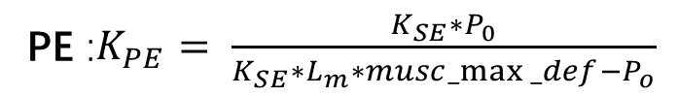
Muscle parameters
$$L_{rest}=\frac{L_{max}+L_{min}}{2}$$
$$L_{width}=L_{max}−L_{min}$$
Damping : $b= \frac{{1.25P}_{0}}{{v+v}_{max/4}}=\frac{{1.25P}_{0}}{v_{max/4}}$ (linear damping)
$T\left(l\right)∈ \left[0.75, 1\right]$ Passive force included
From Hill’s 1938 & Freivalds 2011
$musc_max⁡_def=0.04$ (Winter(1990) and Meijer (1998)
SE :$K_{SE}= \frac{P_{0}}{I_{o}∗\left(1−\frac{L_{f}}{L_{m}}\right)∗musc_max⁡_def}$
From ‘quick release’ method, apply a force as Po, the defection will be the shortening length of tendon. (Winter 1990, Wilkie 1956)
PE :$K_{PE}= \frac{{K_{SE}∗P}_{0}}{{K_{SE}∗L}_{m}∗musc_max⁡_def−P_{o}}$
From $F_{max}= \frac{K_{SE}∗K_{PE}}{K_{SE}+K_{PE}}∗∆x$

Slide 6
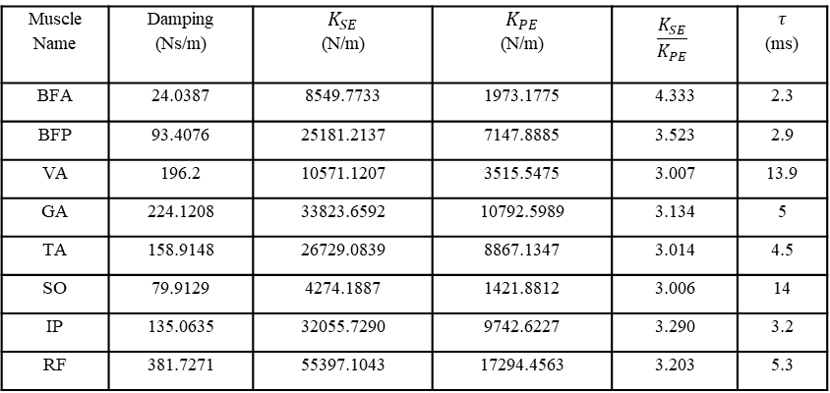
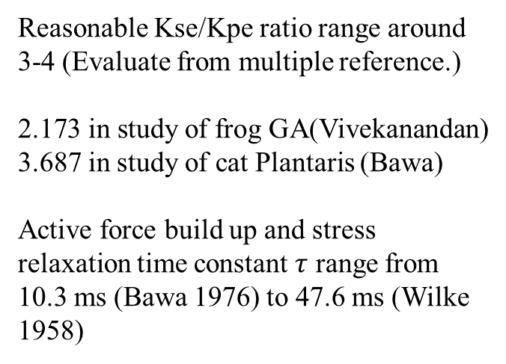
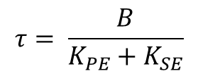
Muscle Passive Tension
Muscle Name | Damping (Ns/m) | $$K_{SE}$$ (N/m) | $$K_{PE}$$ (N/m) | $$\frac{K_{SE}}{K_{PE}}$$ | $$τ$$ (ms)
BFA | 24.0387 | 8549.7733 | 1973.1775 | 4.333 | 2.3
BFP | 93.4076 | 25181.2137 | 7147.8885 | 3.523 | 2.9
VA | 196.2 | 10571.1207 | 3515.5475 | 3.007 | 13.9
GA | 224.1208 | 33823.6592 | 10792.5989 | 3.134 | 5
TA | 158.9148 | 26729.0839 | 8867.1347 | 3.014 | 4.5
SO | 79.9129 | 4274.1887 | 1421.8812 | 3.006 | 14
IP | 135.0635 | 32055.7290 | 9742.6227 | 3.290 | 3.2
RF | 381.7271 | 55397.1043 | 17294.4563 | 3.203 | 5.3
$$τ= \frac{B}{K_{PE}+K_{SE}}$$
Reasonable Kse/Kpe ratio range around 3-4 (Evaluate from multiple reference.)
2.173 in study of frog GA(Vivekanandan)
3.687 in study of cat Plantaris (Bawa)
Active force build up and stress relaxation time constant $τ$ range from 10.3 ms (Bawa 1976) to 47.6 ms (Wilke 1958)

Slide 7
Cartoon of different phases during rat walking
Passive tension on muscles are closely related to joint motion.
Tension in hip muscles are reciprocal during toe off and mid-swing phases as compared to the mid stance and touch down phases.
Tension in ankle and knee joint muscles are mirrored between the stance and swing phases.
In here we could used experimental passive tension data to compare with calculated tension to validate our method and the way we approach the muscle parameters.

Slide 8
Joint Torques
Emanuel’s Torques
Alex’s Torques
Lagrange Torques
Emanuel only provide us the stance Torque, so Alex used Simulink to approach the swing torque but he smoothed the data a lot, thus I’m think of use Lagrange approach to calculate the swing torque.

Slide 9
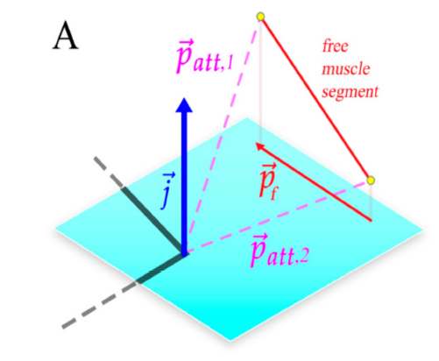
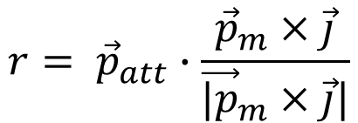
Muscle moment arms
To calculate muscle force for desired joint torque, we need calculate muscle moment arms during walking.
The process are pretty similar to Fletcher’s work, except for two changes:
I only calculate muscle segment that spam through joints.
Muscle segment are not projected on to joint rotation plane, moment arms are now calculate base on the shortest distance between muscle segment vector and joint rotation axis.
$$r= {\vec{p}}_{att}∙\frac{{\vec{p}}_{m}×\vec{j}}{{\vec{|p}}_{m}×\vec{j}|}$$
(Fletcher et.al 2019)

Slide 10
Extension muscle moment arm shape are similar with joint angle, while flexion muscle moment arm shape are inverse of joint angles.
BFP muscle have large moment arm for both hip and knee joint when compare to other muscles due to it biomechanical configuration.
GA and SO moment arm are similar for the ankle joint and inverse shape of TA muscle moment arm.

Slide 11
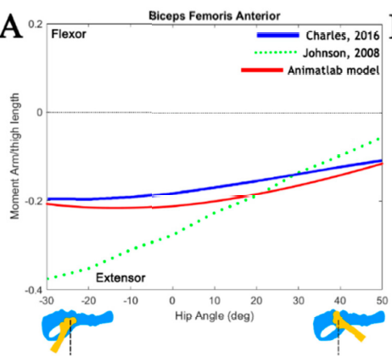
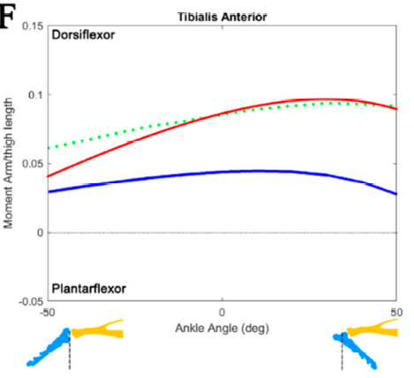
When compare with Fletcher’s work and other, the BFA muscle are nearly identical.
While the TA muscle is a bit shifted up.

Slide 12
Muscle Tension
As we calculated the muscle moment arms, and we got desired joint torque, we can solve for desired muscle tension.
IP
BFA
BFP
RF
VA
TA
GA
SO
T7
T1
T2
T8
T3
T5
T4
T6
Unknowns: Tension [T1 T2 T3 T4 T5 T6 T7 T8]
Equations:
$${Eq1: T}_{1}∗r_{1}+T_{2}∗r_{2}+T_{7}∗r_{7}+T_{8}∗r_{8}−{Torque}_{Hip}=0$$
$${Eq2: T}_{3}∗r_{3}+T_{8}∗r_{8}′+T_{2}∗r_{2}′+T_{4}∗r_{4}−{Torque}_{Knee}=0$$
$${Eq3: T}_{4}∗r_{4}′+T_{6}∗r_{6}+T_{5}∗r_{5}−{Torque}_{Ankle}=0$$
I tried use fsolve to calculate the muscle force, but can’t converge to a steady solution.
Bisect returns NaN, So I used cost function to gradient search for solutions.
(Daniel 2012)
$$Objective=1e6∗\left(Eq1^{2}+Eq2^{2}+Eq3^{2}\right)+1e3∗constraints$$

Slide 13
For example, if we set constraints as summation of all the muscle force, the result return like:
IP
BFA
BFP
RF
VA
TA
GA
SO
T7
T1
T2
T8
T3
T5
T4
T6

Slide 14
Next aims:
Find better constrain function.
Turn the muscle tension into MN activations. So we could compare with the EMG patterns from experimental data.

